Slide 1

[+] Green is Good 558ms
[-] Red is Bad 168ms
Turning Your Checklists into Pester Tests
Rob Sewell @sqldbawithbeard http://sqldbawithABeard.com
Notes:
I will be tweeting links as we go

Slide 2



Speaker Questionnaire
Name : Rob
Occupation : DBA, Automator, Do-er
Interests : PowerShell, Automation And SQL (PaaS geddit?)
Website : sqldbawithAbeard.com
Twitter : @sqldbawithbeard
Interesting Fact : Has a Beard. (Still) Plays Cricket
Speaker : SQL Saturdays, SQL Relay, PowerShell Conference EU
Community : SQL South West , SQL Saturday Exeter , PowerShell Virtual Chapter, Organiser for PowerShell Conference EU 2017, Officer, Lead for dbareports, contributor to dbatools
https://dbatools.io
@psdbatools
https://dbareports.io
@psdbareports

Slide 3

Notes:
Checklists, we all have them and use them wether for installations, processes or even presentations!

Slide 4
What is Pester?
Pester provides a framework for running unit tests to execute and validate PowerShell commands from within PowerShell
https://github.com/pester/Pester
Notes:
Its used for unit testing or TDD but can also be used to validate an environment. Comes with Windows 10 or install from the gallery with Install-Module Pester

Slide 5
Notes:
This is a Pester test running in VS Code

Slide 6
SHOULD OPERATORS
Be Compares one object with another for equality. Case Insensitive
BeExactly Compares one object with another for equality . Case Sensitive
BeGreaterThan Asserts that a number is greater than an expected value.
BeLessThan Asserts that a number is less than an expected value.
BeLike Asserts that the actual value matches a wildcard pattern using -like operator. Case Insensitive
BeLikeExactly Asserts that the actual value matches a wildcard pattern using -like operator. Case Sensitive
BeOfType Asserts that the actual value should be an object of a specified type
Exist Does not perform any comparison but checks if the object calling Exist is present in a PS Provider.
Contain Checks to see if a file contains the specified text. Case Insensitive
ContainExactly Checks to see if a file contains the specified text. Case Sensitive
Match Uses a regular expression to compare two objects. Case Insensitive
MatchExactly Uses a regular expression to compare two objects. Case Sensitive
Throw Checks if an exception was thrown in the input ScriptBlock.
BeNullOrEmpty Checks values for null or empty (strings).
I Hate slides with lots of text but I think this one is valid

Slide 7

What Can You Validate?

Slide 8
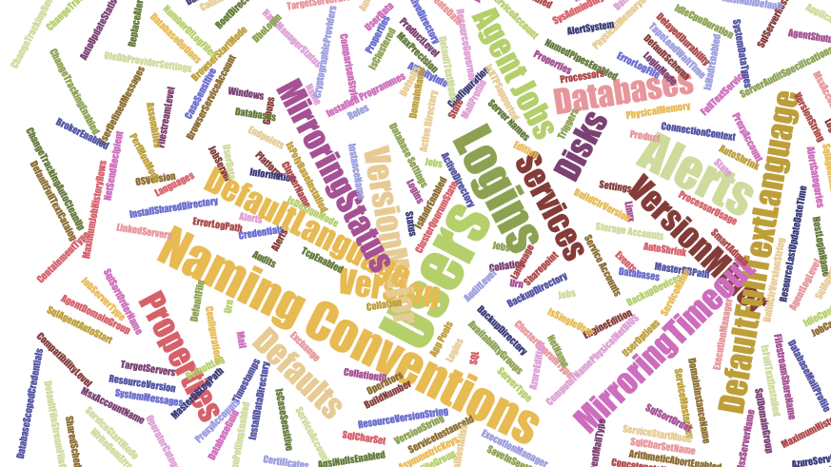
What Can You Validate?
Maybe not EVERY thing but anything that you can check with PowerShell
$srv|Get-Member -MemberType Property |Select-Object name
$srv|Get-Member -MemberType Property |Select-Object name
$srv.JobServer | Get-Member -MemberType Property |Select-Object name
$srv.Databases | Get-Member -MemberType Property |Select-Object name
$srv.Configuration | Get-Member -MemberType Property |Select-Object name

Slide 9

MUST BE TIME
FOR A DEMO

Slide 10
Round Up
We all have checklists – manual testing is error-prone
Pester is a Unit Testing Framework for PowerShell
You can use it to validate your infrastructure
The basic syntax uses Describe, Context and It Code blocks
The Should command is used for testing assertions
Use the NunitXML output and the reportviewer.exe to make HTML reports
Rob Sewell @sqldbawithbeard http://sqldbawithAbeard.com

Slide 11
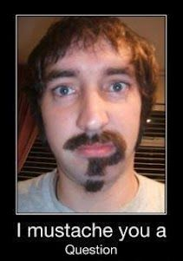
Questions ?

Slide 12
THANK YOU SO MUCH
Here are some cool free things
PASS PowerShell Virtual Chapter https://sqlps.io add /video for Youtube channel
SQL Community Slack https://sqlps.io/slack
dbatools – Amazing PowerShell module for DBAs https://dbatools.io
dbareports – SQL PowerShell SSRS PowerBi & Cortana https://dbareports.io
SQL Collaborative Git Hub Organisation https://github.com/sqlcollaborative
Influence Microsoft
sqlserver PowerShell module https://sqlps.io/vote
SSMS https://sqlps.io
PowerShell PowerBi integration https://sqlps.io/powerbi
Rob Sewell @sqldbawithbeard http://sqldbawithAbeard.com

